Slide 1

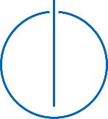


Master’s Thesis in Informatics
Reinforcement Learning for Autonomous
Locomotion Control of Snake-Like Robots
Author: | Christian Lemke
 | Christian.Lemke@campus.lmu.de
Supervisor: | Prof. Dr.-Ing. habil. Alonis Knoll
Advisor: | M.Eng. Zhenshan Bing
Date: | 27.07.2018

Slide 2
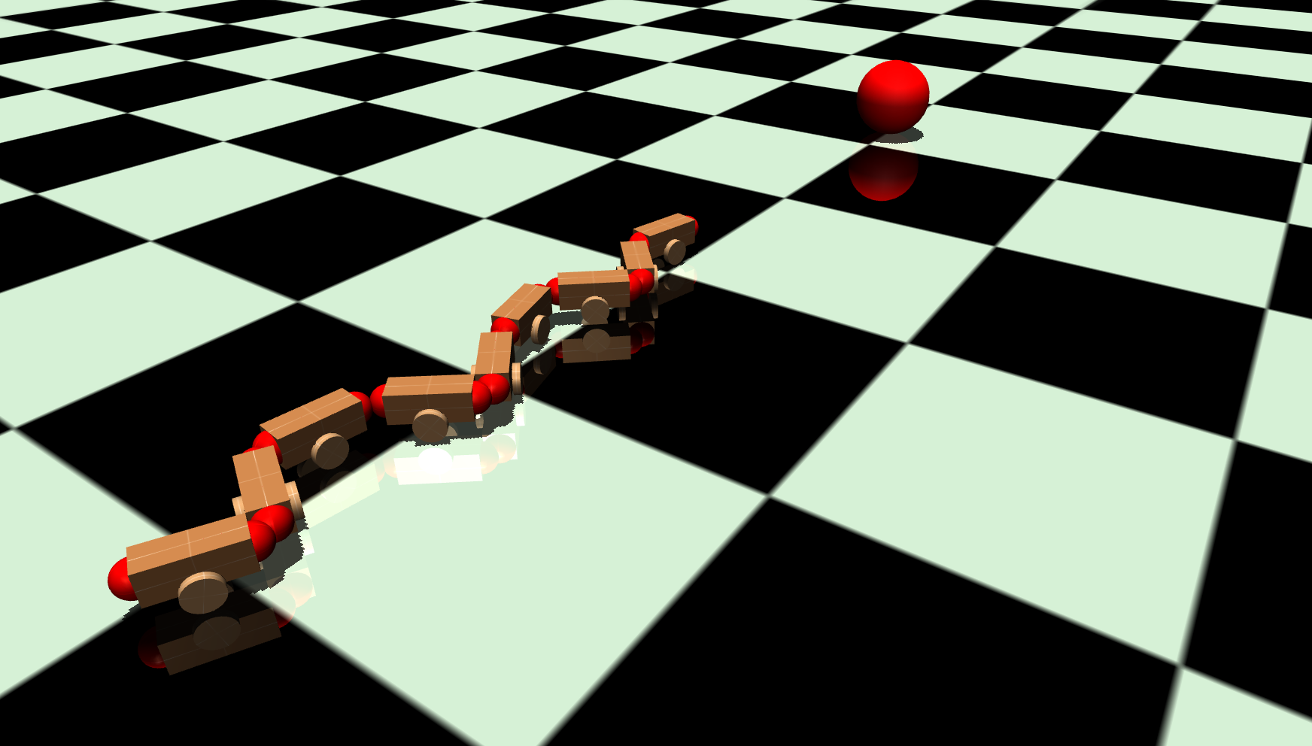
Content
Background of Snake-Like Robots
Background of Reinforcement Learning
Simulation environment
Two control experiments
Conclusion
Notes:
As introduction
Snake-Like Robots. Advantages Use cases and problems
As Background
RL
Simulation Environment and the Robot Model… as you already see on the right.
Serves as the RL environment for the following two experiments.
Sum up in the conclusion

Slide 3
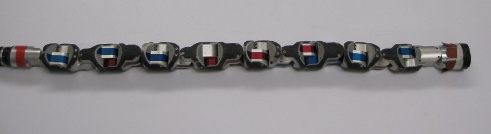
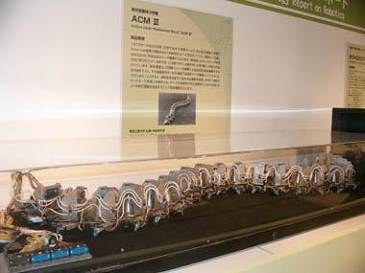
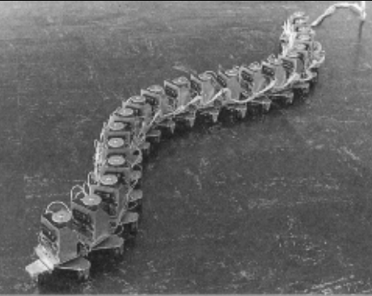
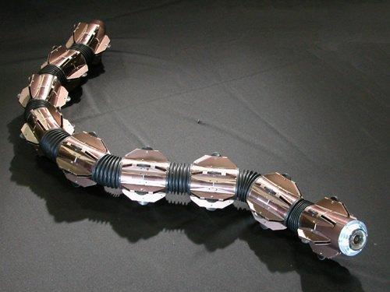

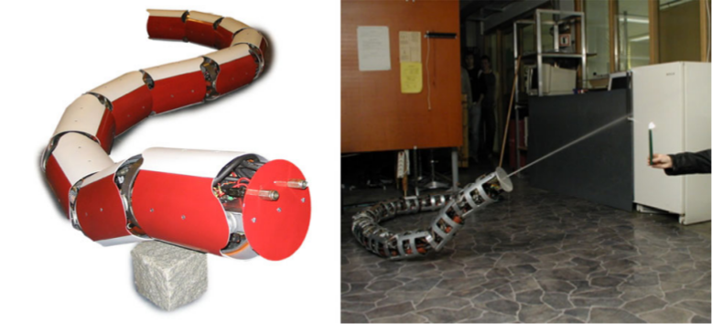
Snake-Like Robots
Uncle Sam
Mobility:
Swim in water
Climb stairs and poles
Move in narrow spaces
Use cases:
Fire fighting
Inspection and maintenance
Search and rescue
ACM III (1972)
ACM-R5 (2005)
Sources: Tokyo Institute of Technology | Shigeo Hirose, Peter Cave, and Charles Goulden. Biologically inspired robots: serpentile locomotors and manipulators. Oxford University Press, 1993 | LILJEBÄCK, Pål, et al. Snake robots: modelling, mechatronics, and control. Springer Science & Business Media, 2012. | Biorobotics Lab Carnegie Mellon University. http://biorobotics.ri.cmu.edu/projects/modsnake/
Notes:
Snake-Like Robots
Due to their body shape highly flexible which enables them to move in different environments
Advantage: mobility in unknown and challenging environments
Mobility
Swim
Climb
---
https://www.titech.ac.jp/english/research/stories/shigeo_hirose.html
Uncle Sam is a mobile snake inspired camera platform
https://www.artstation.com/artwork/woVXg

Slide 4
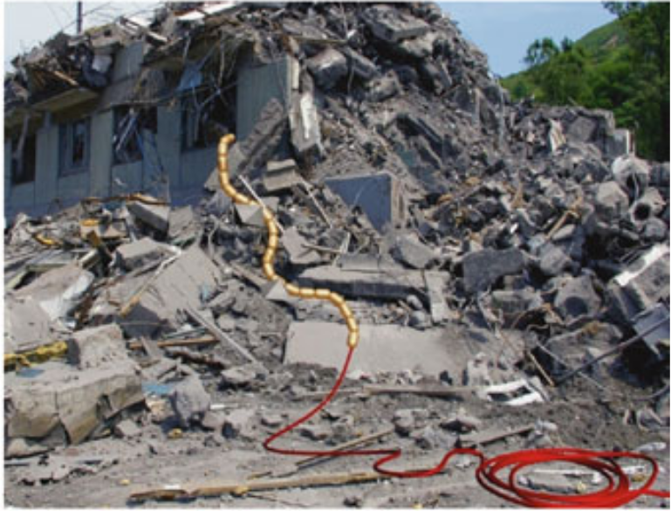
Snake-Like Robots
The modeling and control problems:
Highly redundant degrees of freedom
Complex interaction with the environment
Difficult to control in real-world situations
Question:
How to solve this complex control problem?
Approach:
Reinforcement Learning
Experiments:
Autonomous Locomotion Control
Autonomous Target Tracking
Search and rescue scenario
Sources: LILJEBÄCK, Pål, et al. Snake robots: modelling, mechatronics, and control. Springer Science & Business Media, 2012.
Notes:
Snake-Like Robots
In case of search and rescue for example it has to be able to move on cludered ground.
So for these use cases the robots require controllers that can handle:
their high degree of freedom and
the complex interaction with cluttered and irregular environment
Question: How to solve this complex control problems?
I present a novel approach using AI with the Reinforcement Learning method. This way better adapt to unknown environments.
I will show the RL possibilities in two experiments.
Fist perform a Locomotion control
Second perform target tracking
---
The many degrees of freedom of snake robots make them difficult to control but provide potential locomotion skills in cluttered and irregular environments which surpass the mobility of more conventional wheeled, tracked, and legged robots.

Slide 5
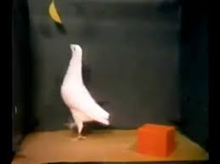
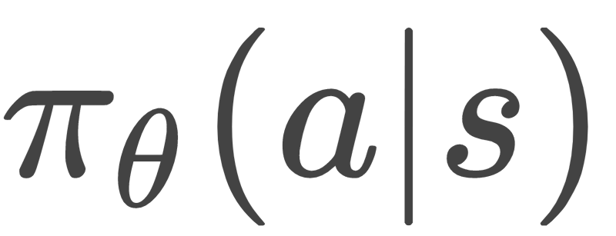
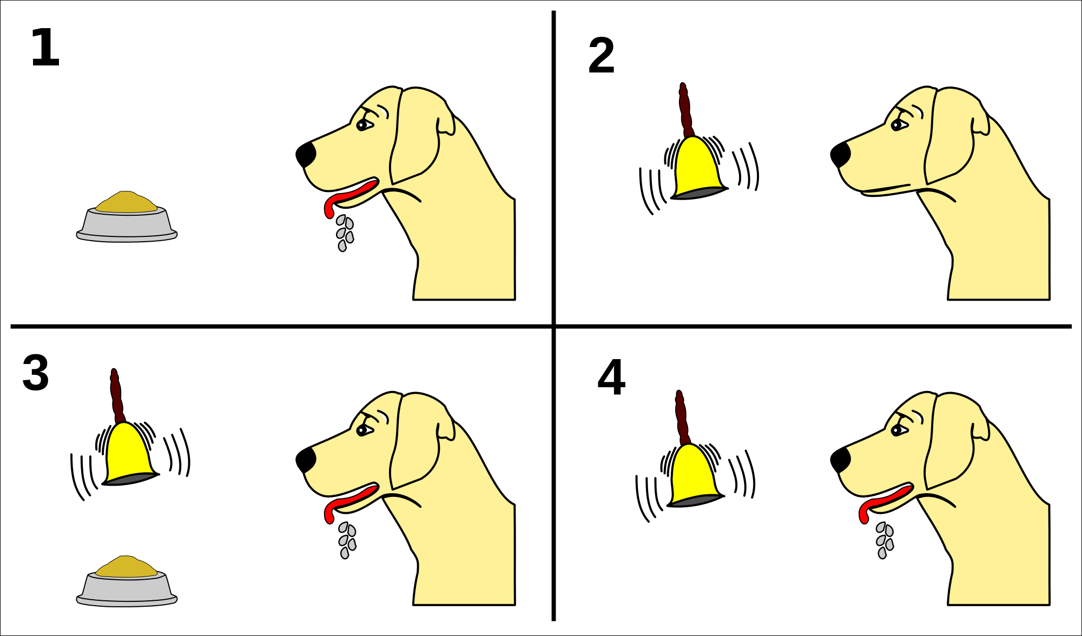
Reinforcement Learning
Environment
Reward,
State
Action
Agent
Policy
Box-and-Banana Problem
Proximal Policy Optimization
Best performance on continuous control tasks
Easy to implement
Good sample efficiency
Small hyperparameter tuning
Pavlov dog conditioning
Sources: https://commons.wikimedia.org/wiki/File:Pavlov%27s_dog_conditioning.svg
Sources: Dr. Epstein. https://www.nytimes.com/1984/04/17/science/science-watch-pigeons-show-how-to-solve-a-problem.html | Schulman et al. "Proximal policy optimization algorithms." arXiv preprint arXiv:1707.06347 (2017).
Notes:
Reinforcement Learning
Now I give a short overview over RL which is a ML technique.
In RL a agent interacts with an environment and uses try and error to train a policy.
A agent performs actions on a environment. The environment returns a reward for how good that action was and the next state.
The agent tries to maximize the cumulative rewards.
Such learning process can also be observed with animals.
I show it with the Box-Banana Problem.
Here the agent is a pidgin and the environment a small cage with a banana and a box.
Pidgin has to observe the environment and has perform a action “move the box” to be able to reach the reward “banana”.
PPO
This thesis uses the state of the art RL algorithm of Proximal Policy Optimization.
---
Pidgin
''Tests like this one show how the different skills of an organism can enable it to perform actions that it has never done before.''
PPO
Policy gradient methods have a mein problem in estimation the step size of a policy update.
Previous approaches try to calculate the step size.
This approach solves the problem with the step size by directly constraining it.
The policy is trained to increase the likelihood of actions that give high reward.
It handles continues action and state space. In the Experiments of Jon schulman at Open AI it achieved the best performance in those continues control tasks.
A policy is a distribution over actions given states.
An AI or agent takes action inside of an environment. At each time step the agent will receive the input of the current state and take an action. Then receive a reward as well as the next state. The agent will choose which action to take based on some policy. The goal is to find a policy that maximizes the cumulative reward over some time horizon.
In the context of our problem the agent is the robot
Policy Gradients:
Stochastic policies are distributions over actions given states. In other words, this distribution gives you the mapping.
If you are in state s give me probability for action a,b,c...
Let \(\theta \in \mathbb{R}^{K}\) denote a policy's parameter vector with \(K\) parameters and \(J(\theta)\) a policy objective function which has to be maximized.
r t (θ) denotes a probability ratio between a new policy π θ (a t |s t ) and a old policy π θ old (a t |s t ) at time step t.

Slide 6
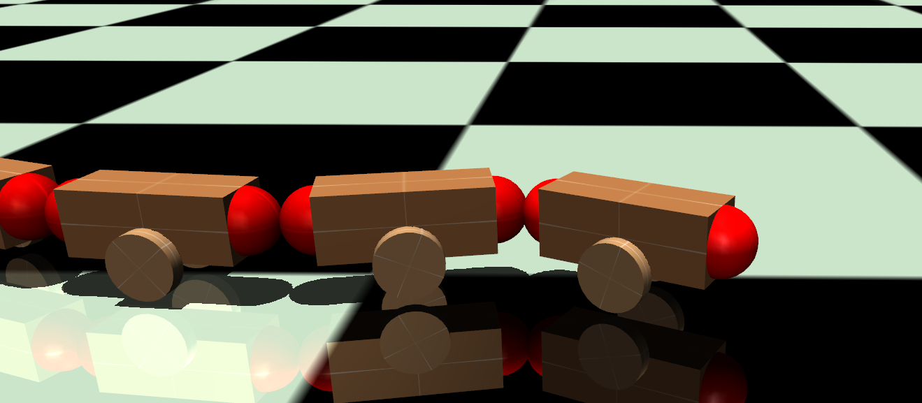
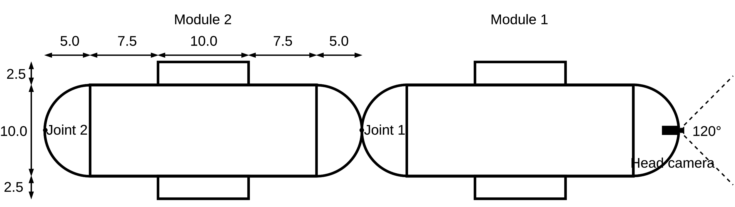

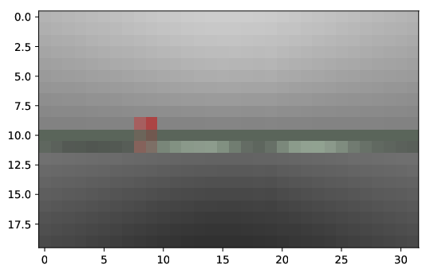
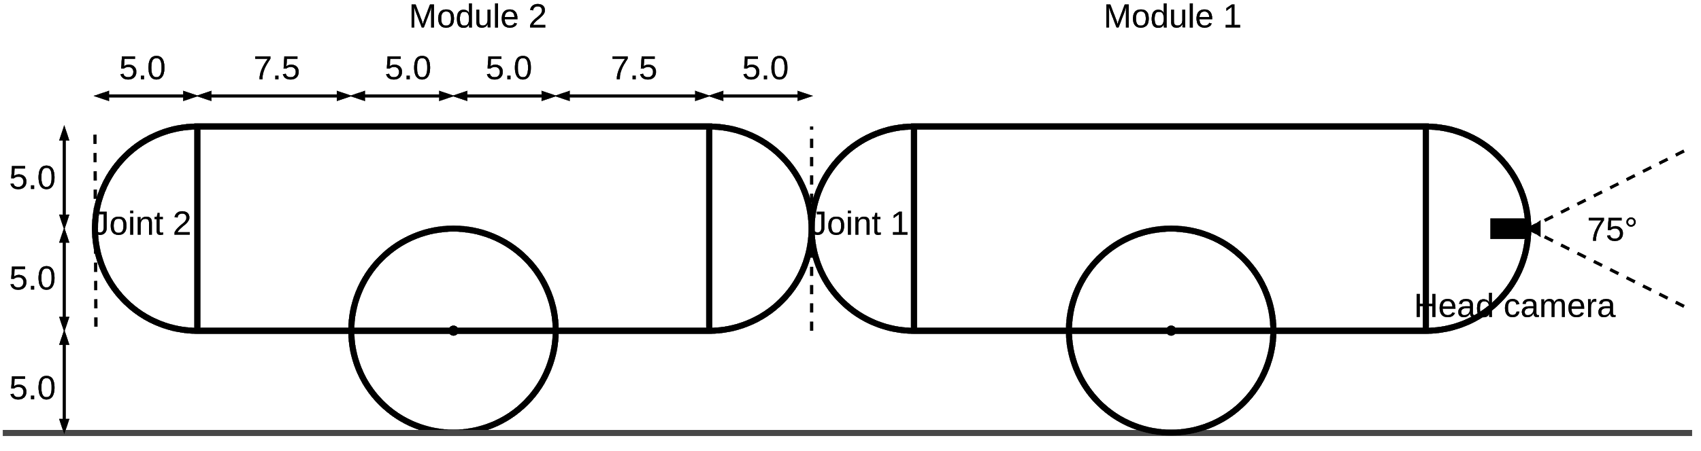
Environment and Robot
9 Modules and 8 Joints
Servo position motors
Wheels
Vision via head camera
Ubuntu 16.04
Python 3.5
The robot in MuJoCo
Tensorflow
Controller
MLP
MuJoCo
mujoco-py
Gym
Environment
Vision of head camera
Rendering with
32x20 RGB
Components overview
Notes:
Environment and Robot
Now i present you my developed Simulation environment.
I developed an planar snake robot with 9 modules and 8 joints.
The wheels imitate the friction of the snake skin to the ground.
For Vision it uses a Head camera that renders images in a low resolution RBG image.
I used Tensorflow, Mujoco as simulation environment, Gym as RL framework … as shown in this overview.
----
Wheels imitate the anisotropic friction of the skin.
Vision from a head camera

Slide 7
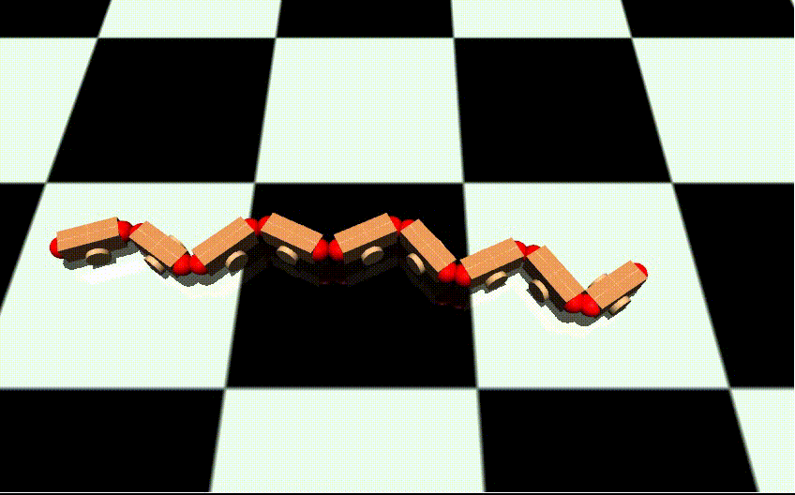
1. Experiment: Autonomous Locomotion Control
Task:
Perform a power efficient locomotion at a specified velocity.
Learn:
Joint position commands for slithering locomotion
Control velocity
Power efficiency
Evaluation:
Comparison to traditional equation controller
Notes:
Fist of two experiments: Autonomous Locomotion Control
Letz apply RL to this environment to generate a snake robot slithering controller.
In addition to that, since the snake robot is a mobile system, the locomotion has to be power efficient.
Task: Perform a power efficient locomotion at a specified velocity
Learn:
How to control the joints to perform slithering
Control velocity
Power efficiency
For evaluation I will compare the performance to a traditional controller.
---
Can the PPO algorithm learn efficient locomotion control?
Lilyack says as a mobile system its locomotion needs to be efficient because power is limited.

Slide 8
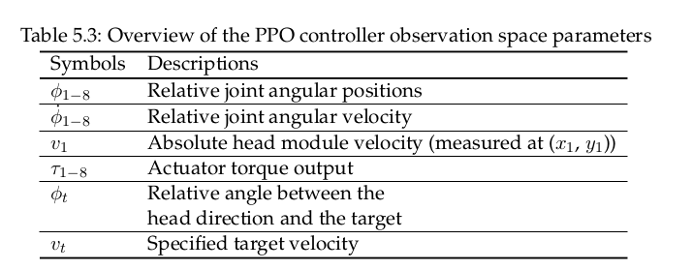
1. Experiment: Autonomous Locomotion Control
Observation Space and Action Space
Environment
Controller
Environment
Observation space [27]
Action space [8]
Head module velocity [1]
Joint positions [8]
Joint angular velocities [8]
Head direction [1]
Actuator torque outputs [8]
Specified target velocity [1]
Joint positions [8]
Observation
Action
0.25 m/s
Notes:
Observation Space and Action Space
So how did I implement the RL observation and action space.
I defined this observation space.
This means the controller has the following inputs:
Head module velocity
Joint positions
Joint angular velocities
Head direction (direction for the locomotion)
Actuator torque (needed to measure the power usage)
Specified target velocity (directly defined)
These 27 variables are used for the policy to make the decision how to set the joint positions.

Slide 9
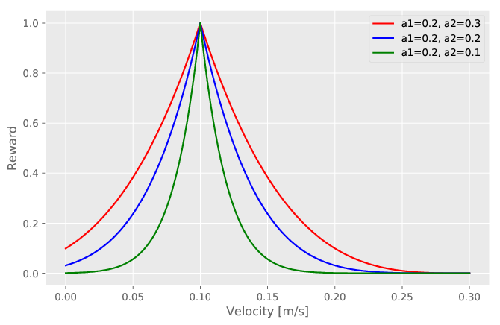
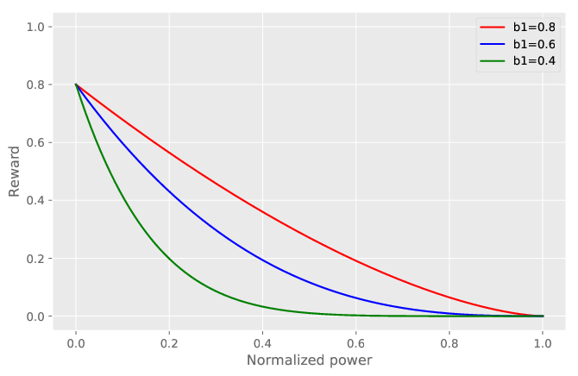
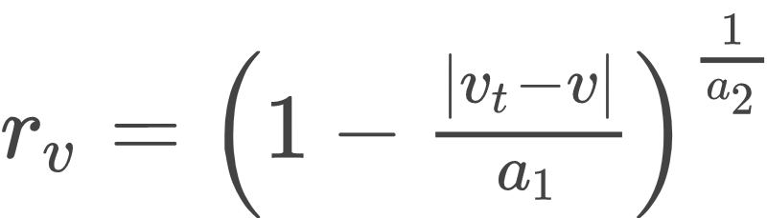
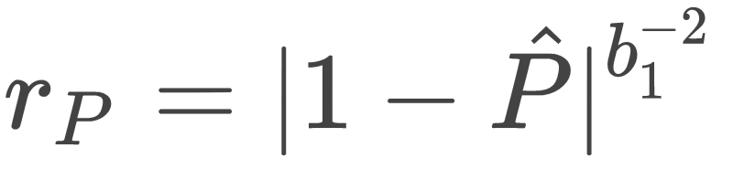
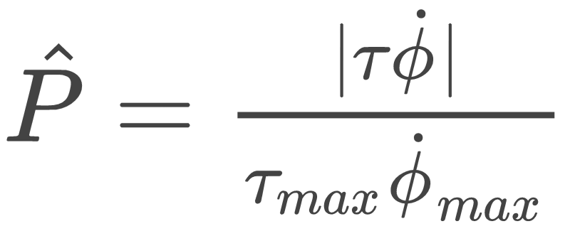
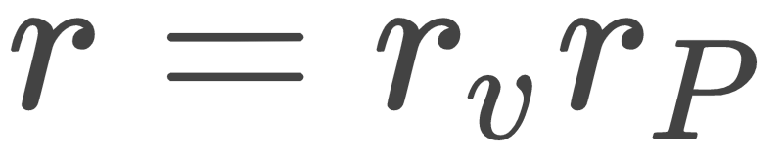
1. Experiment: Autonomous Locomotion Control
Reward Function
Reward velocity:
Reward power efficiency:
Reward is combination of velocity and power usage
Reward power usage
Notes:
Reward Function
Developing reward functions in RL is always challenging. Especially if multiple conditions have to be concerned.
My reward function solution consists out of two components.
Left ...
The reward for keeping the right velocity. The highest reward is obtained by maintaining a the specified velocity here 0.1 m/s.
Right…
The reward for minimizing the power usage. The highest reward is obtained as the power usage goes to zero. I calculated the power usage by multiplying the torquer with the joint velocity.
Both rewards are normalized so they can be easier combined together.
Here they are just multiplied together.
---
For the sake of completeness
Just training to reach the most efficient locomotion doesn't work. The snake would learn to not move at all.
“Reward shaping” : Process of manually designing a reward function that needs to guide the reward function to a desired behavior.
TODO üben des gut zu erklären!
Bla hier gut …, da target velocity, da weniger power used…

Slide 10
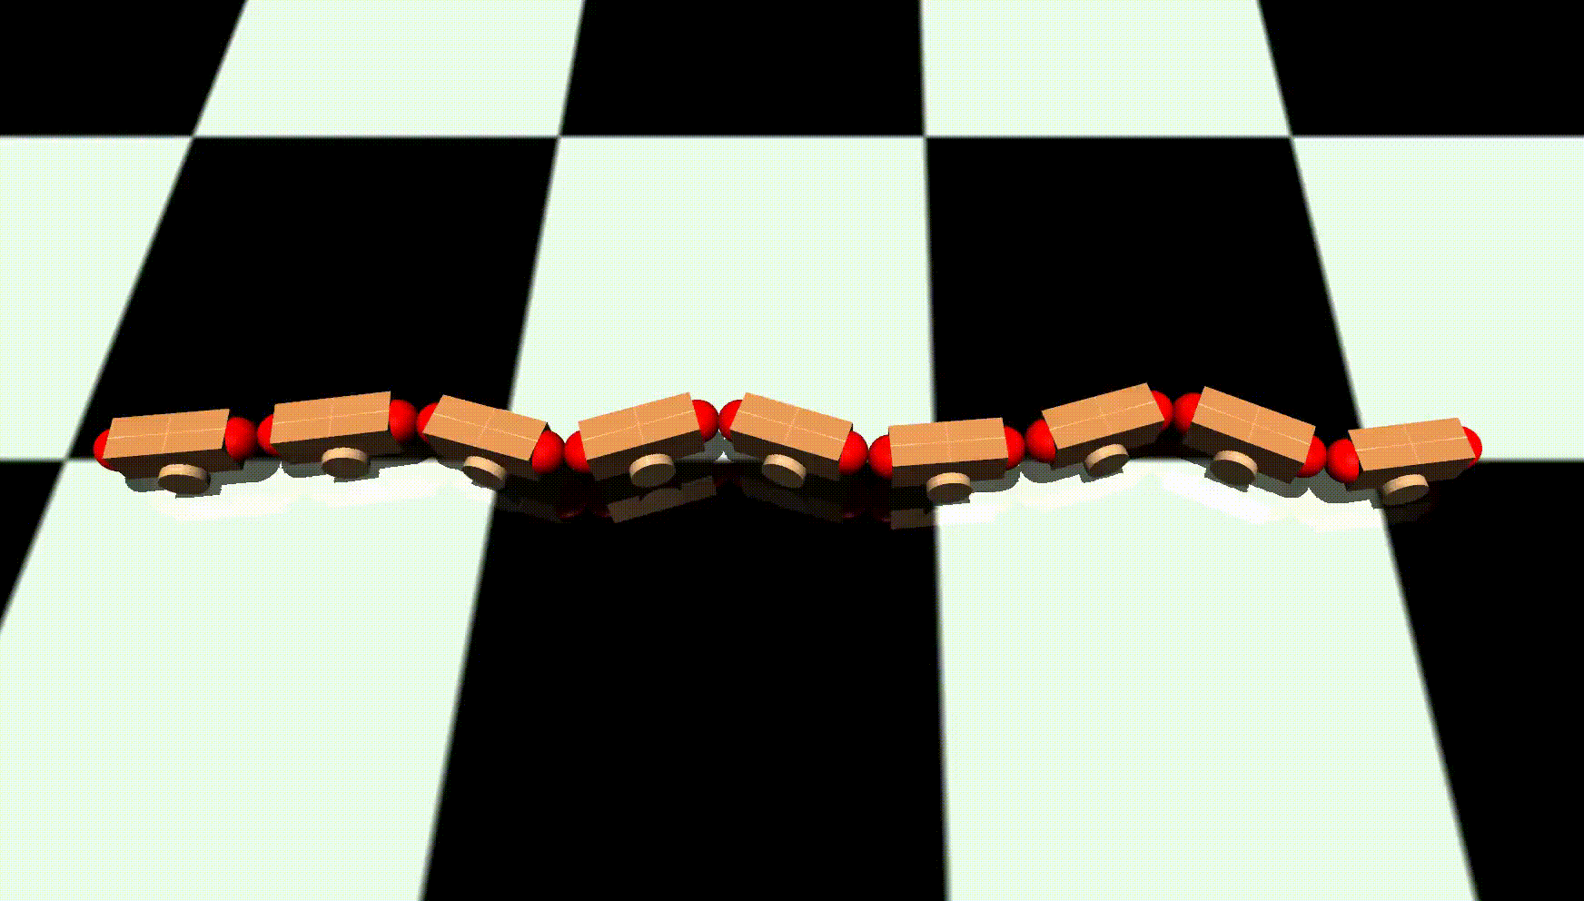
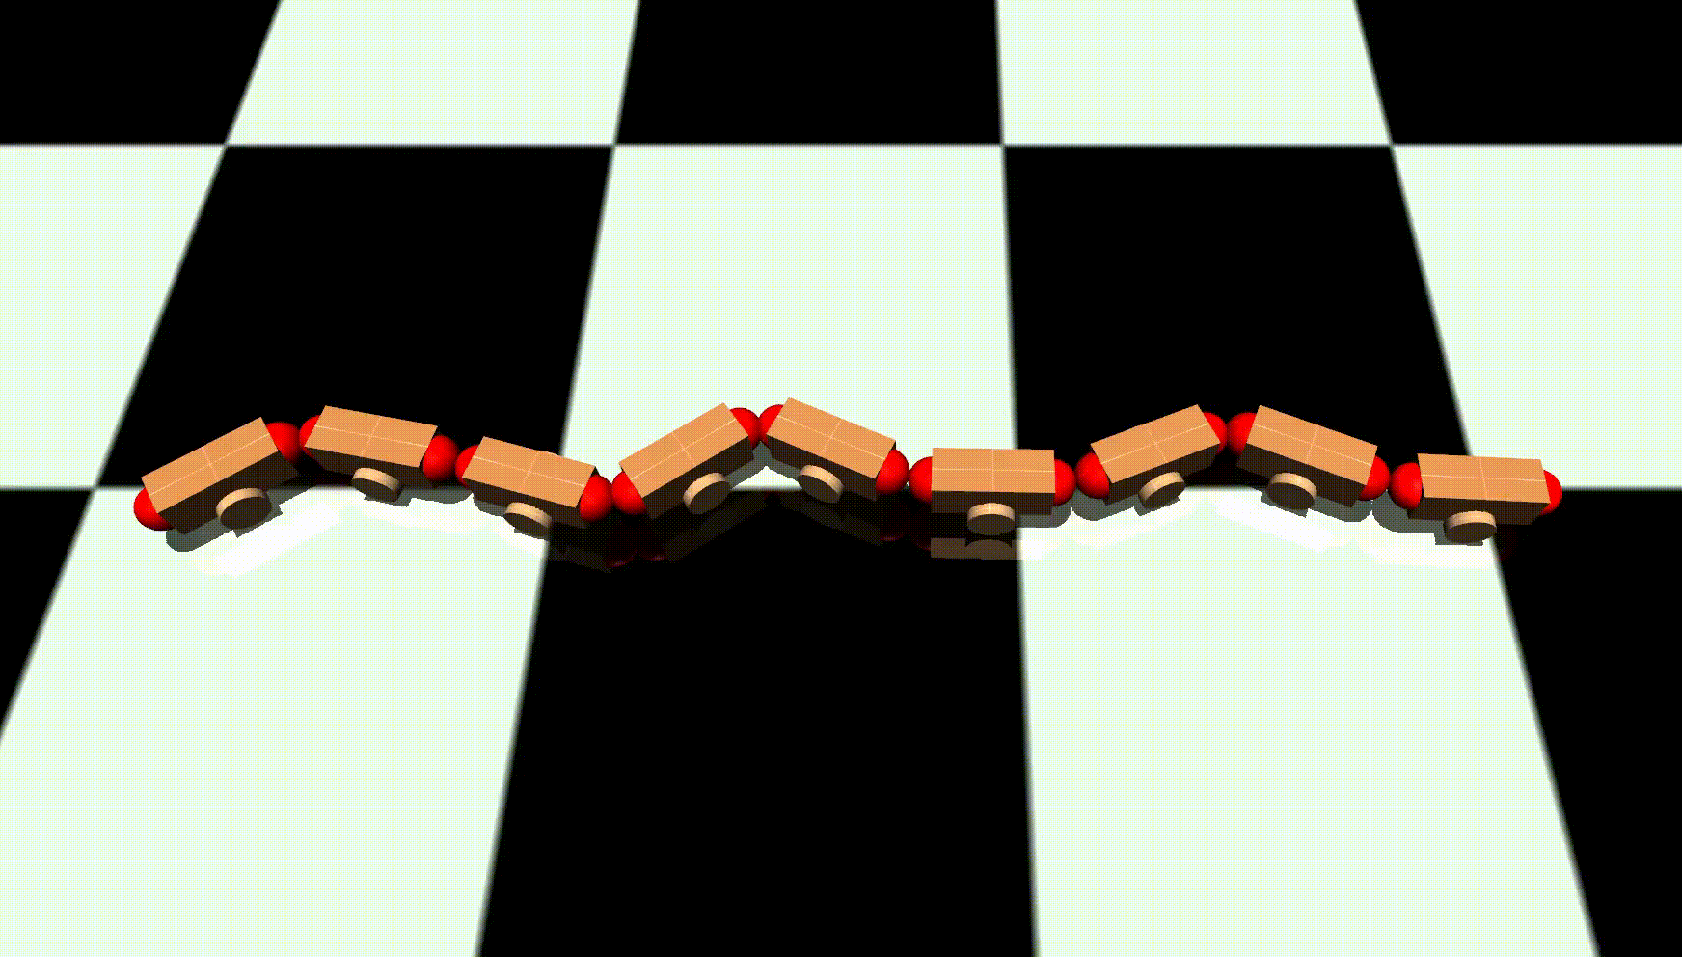
1. Experiment: Autonomous Locomotion Control
Results
0.5x speed
0.5x speed
Velocity of 0.05 m/s
“Concertina” gait pattern
Contracts and stretches the body
Velocity of 0.25 m/s
“Lateral undulation” gait pattern
Carries waves from head to tail
Notes:
Results
As result letz look at the locomotion.
The controler is able to move at different veloceties.
On the left the lowest. I observed a so called “concertina” gait.
On the right I observed a typical “Lateral undulation” gait pattern
So as result .. the locomotion works!
Note the policy is able to adapt between different gaits and velocities.

Slide 11
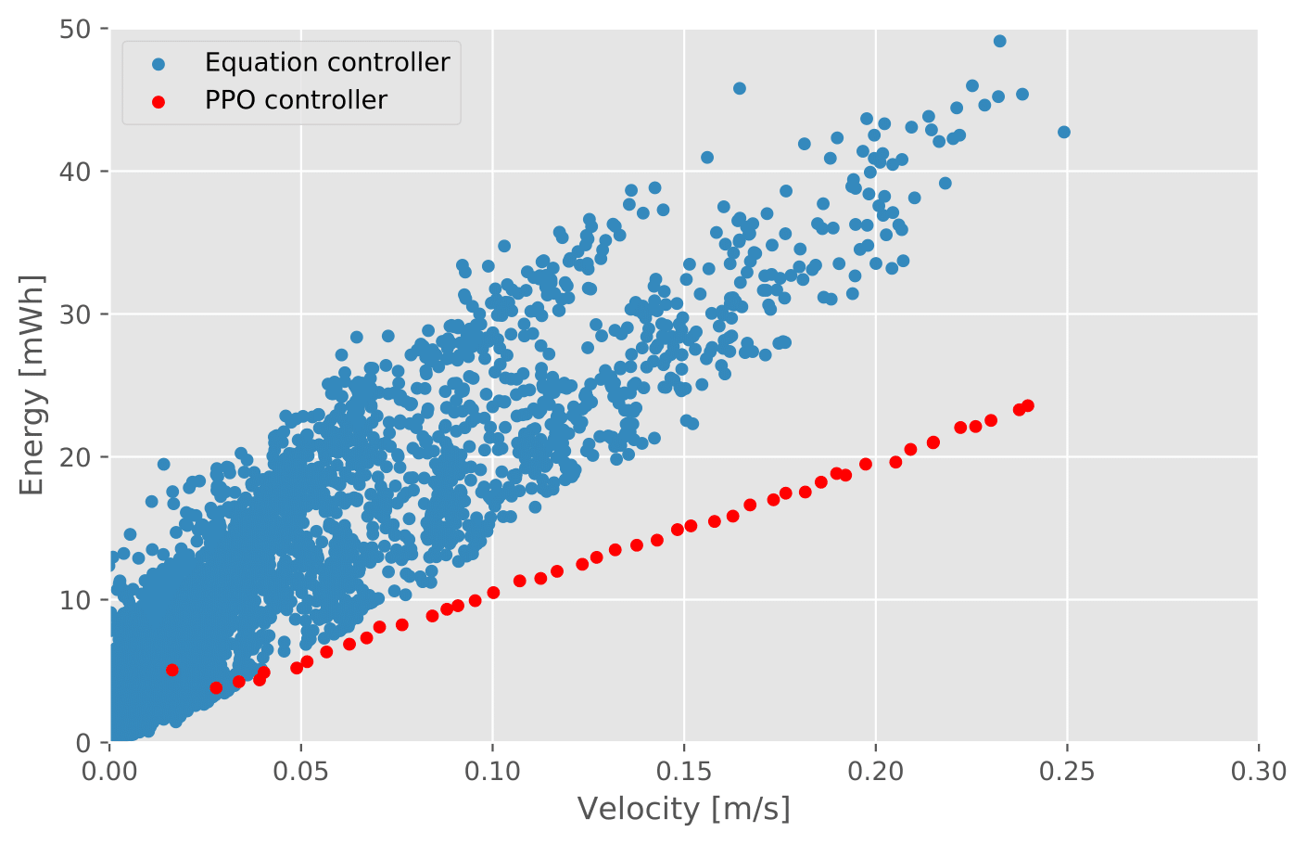
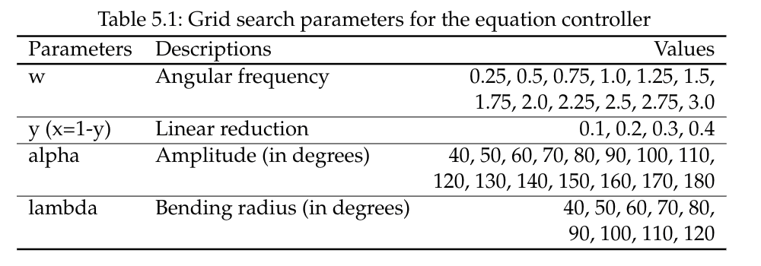
1. Experiment: Autonomous Locomotion Control
Comparison with traditional Equation Controller
An efficiency comparison
Grid search creates a variety of different gaits
Total of 6480 gait parameter sets
Table of the equation controller parameters
Notes:
Comparison with traditional Equation Controller
What about power efficiency?
I compared the RL controller with a traditional gait controller.
I called it the “equation controller”.
This controller takes for different equation parameters as input. (shown in the table)
I used a parameter grid search to generate 6480 different movement gaits to obtain power efficient ones.
As result, in my simulation environment the RL controller over all outperforms it in terms of energy efficiency.
----
For the sake of completeness
This scatter plot shows the parameter grid search result of the equation controller.
a Cartesian product created 6480 different movement parameter sets.
Each data point represents a result in terms of power efficiency and velocity.
The lower edge of the point cloud represents the most efficient movement parameters
for the equation controller.
Trained a range of 0.05-0.25 m/s

Slide 12
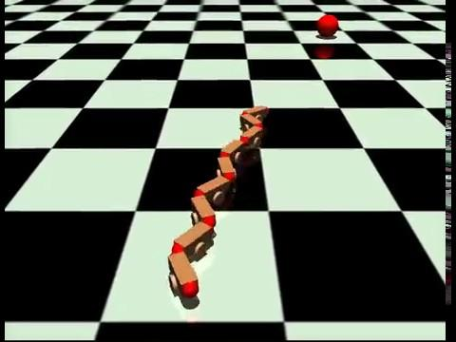
2. Experiment: Autonomous Target Tracking
Task:
Follow a moving target with a certain distance.
Learn:
Control joints for locomotion
Use head camera to track the target and estimate the distance
Evaluation:
Test on different target tracks
Notes:
2. Experiment: Autonomous Target Tracking
Ok letzt look at my second experiment.
It has the task of Following a moving target at a certain distance
In this the agent has to learn how to again use control the joints
Use a head camera for vision and estimate the distance

Slide 13
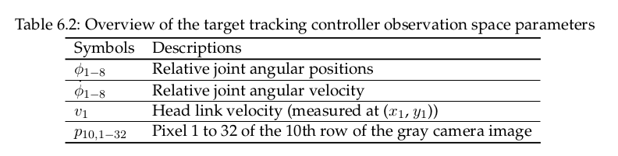
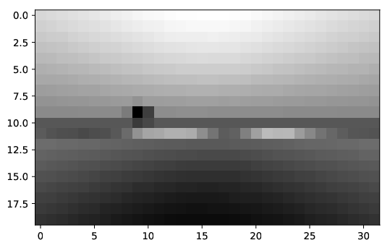
2. Experiment: Autonomous Target Tracking
Observation Space and Action Space
Environment
Controller
Environment
Observation space [49]
Action space [8]
Joint positions [8]
Joint angular velocities [8]
Head module velocity [1]
Head camera Pixels [32]
Joint positions [8]
Observation
Action
Select one row:
32x20 to 32 Pixels
Notes:
Observation Space and Action Space
Again my observation and action space implementation
I am using the joint information as before.
To obtain information of the target position and distance i use head camera images.
But here I directly feed in raw pixel values.
---
würde da fast alles weg und sagen so quasi wieder dasselbe obs durchs netz und wir kriegen die angles der joints
dann sagen aaaaber obs jetzt anders und den cam input da auf ne eigene seite und sagen "das hier plus wie die joints grad liegen etc"

Slide 14
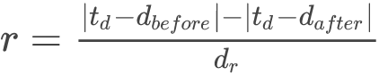
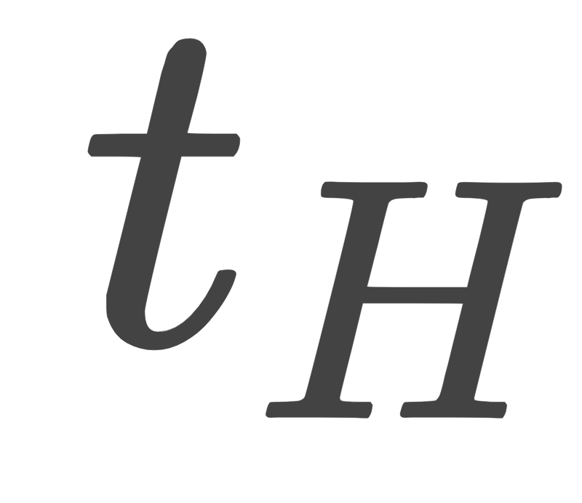
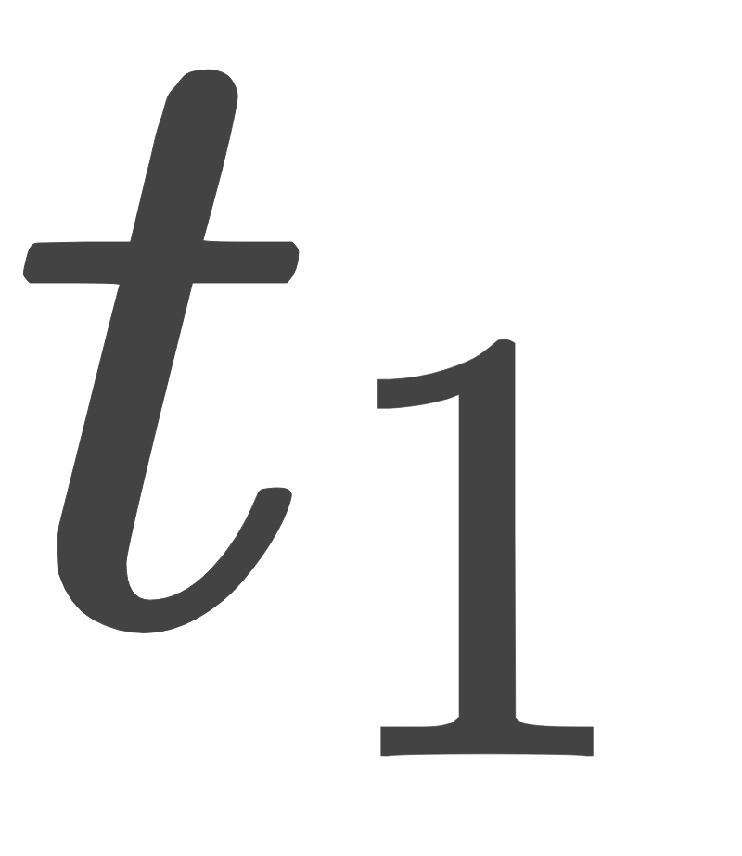

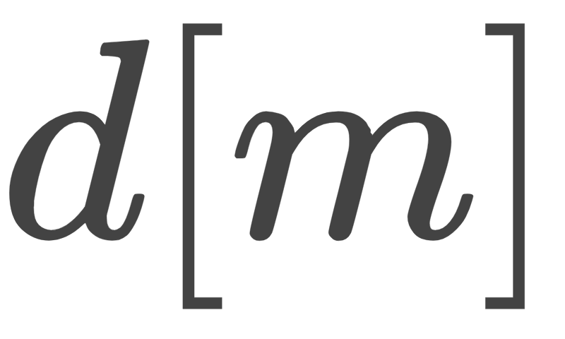
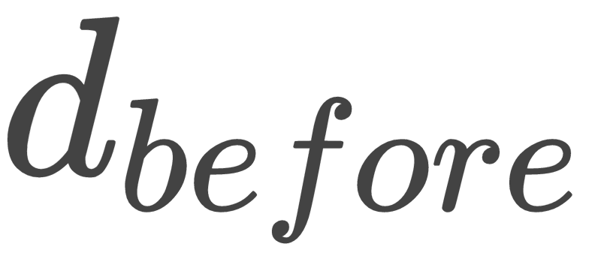
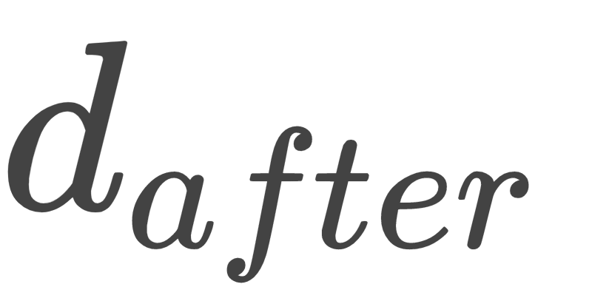
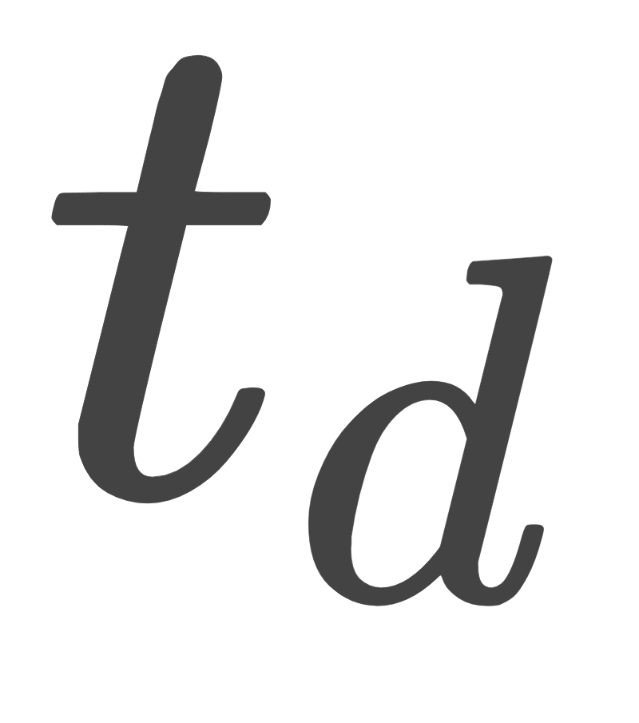
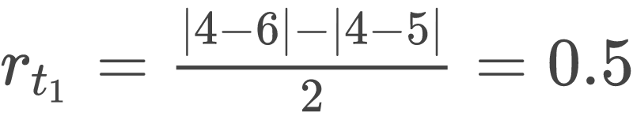
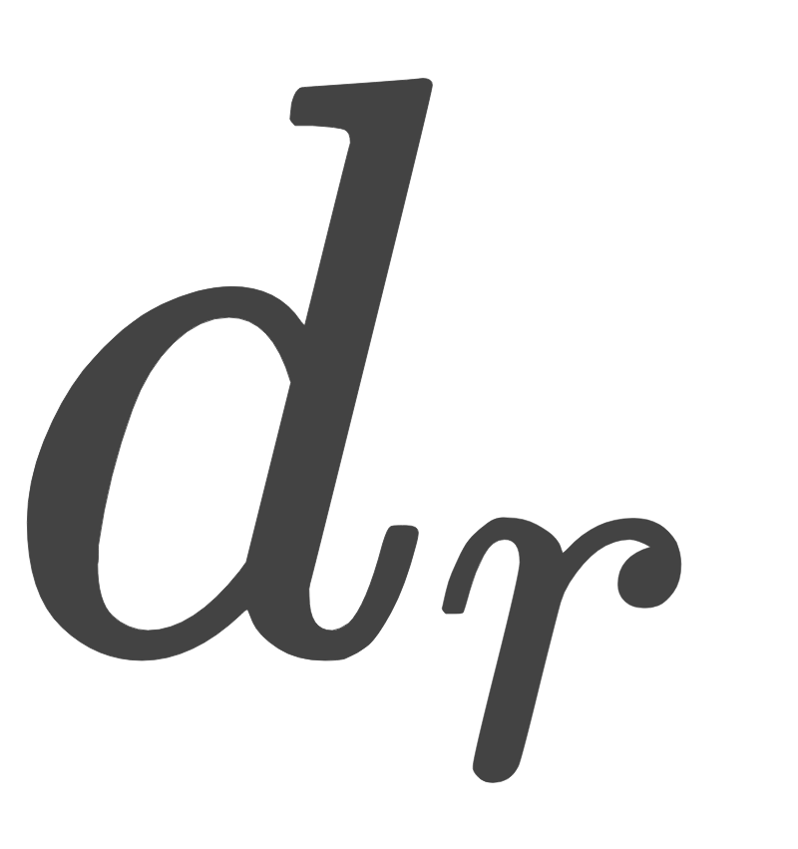
2. Experiment: Autonomous Target Tracking
Reward Function
6
5
4
3
2
1
0
Notes:
Reward Function
The reward is achieved by the change in distance towards the target distance.
X axes, y axes
Notice something is missing… I didn’t use any vision information in this reward function. So no rules for keeping facing the target or even to keep it in sight.
So vision information is in observation space but not used as reward.
-----

Slide 15
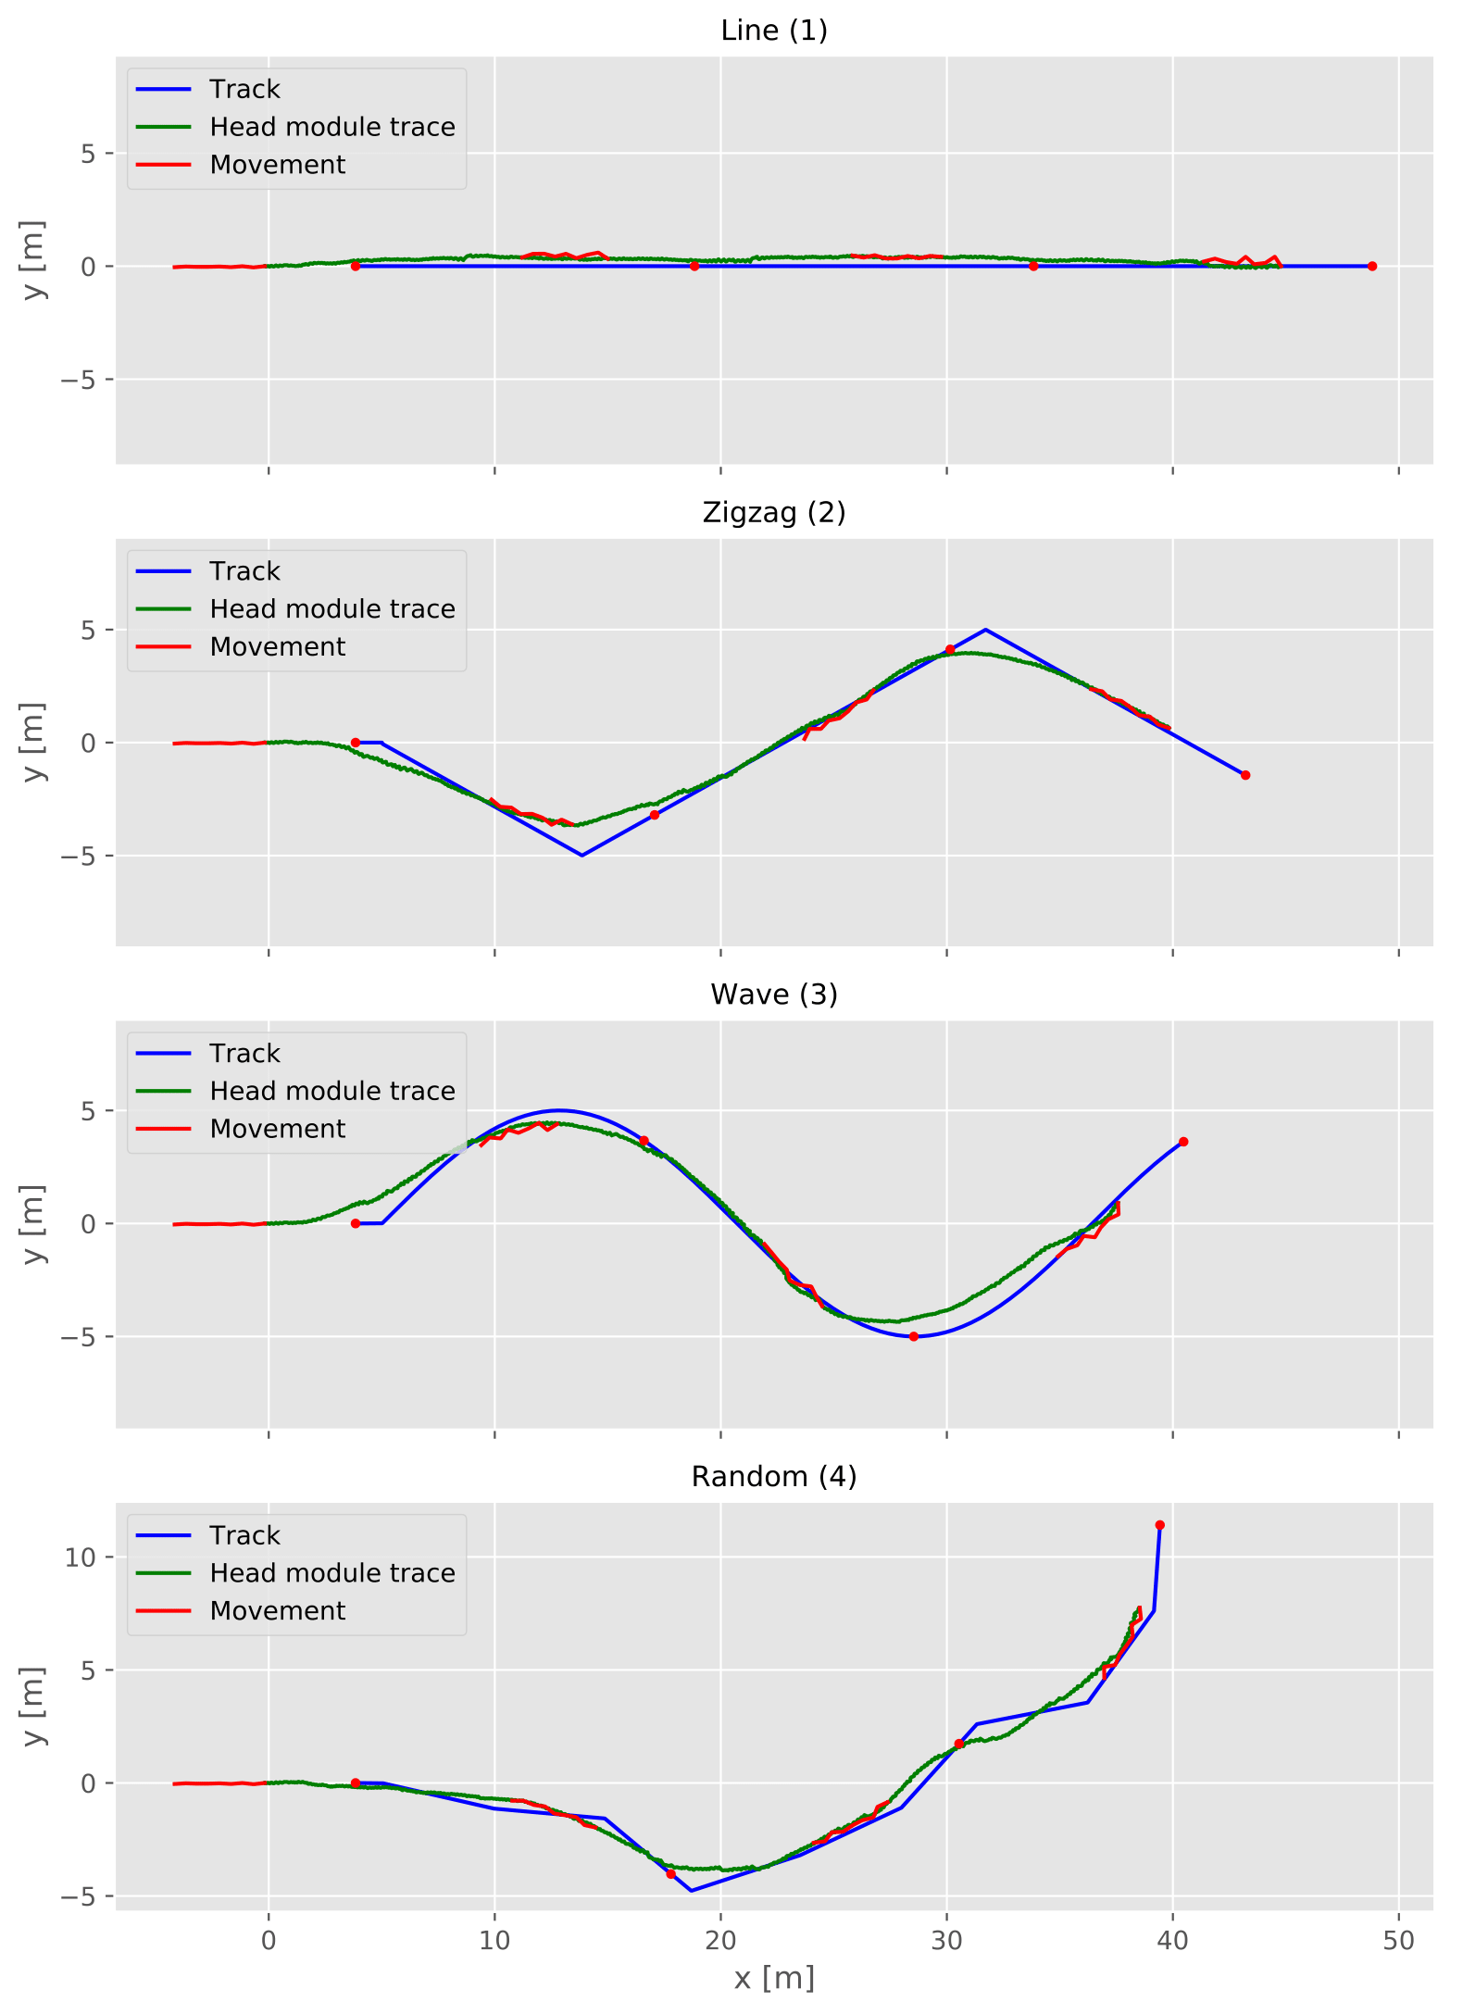
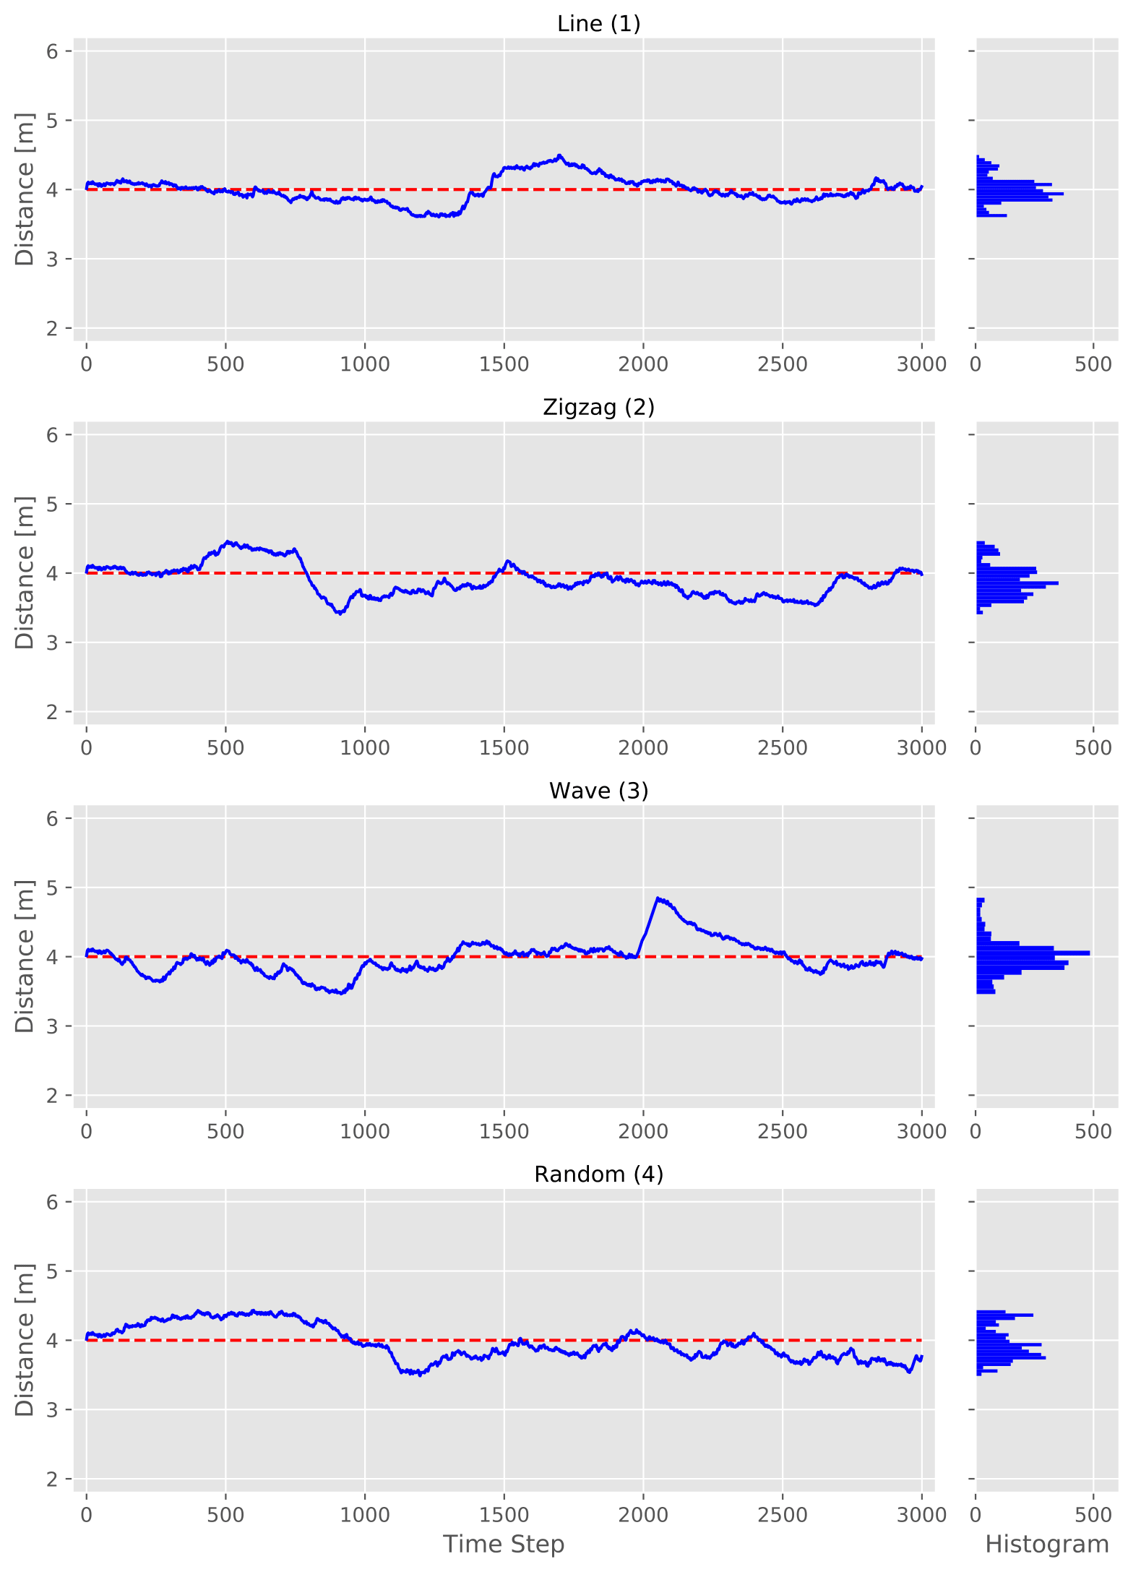
2. Experiment: Autonomous Target Tracking
Result

Slide 16
Conclusion
Advantages:
Directly solves the problem
No control engineering
Disadvantages:
Challenging to develop suitable reward functions
The policy is difficult to interpret
Future work:
PPO on a real robot
3D Snake-Like Robot Model
Explore gait adaptiveness on 3D model
Notes:
Conclusion
I successfully showed that RL is able to generate autonomous locomotion controllers for snake-like robots.
I developed an environment with a snake robot.
In the first experiment I was able to train a agent to perform a power efficient locomotion at range of velocities.
In the second experiment I successfully trained a agent to perform a target tracking behavior using raw pixel values.
Advantages:
Like all ML methods it PPO can be applied on many different problems. Here we have a one algorithm that can create controllers for a variety of robots.
Directly solves the problem. Means no development for image processing or control engineering required. Also directly learns the dynamics of the environment. Requires no previous human knowledge
Disadvantages:
As Neuronal network the model is difficult to interpret and its actions hard to predict
Not suitable for safety critical scenarios.
Future work:
Transfer
A model that could be transferred to a real snake robot.
Require more realistic robot simulation could be developed and used to train.
3D
Build a 3D model.
Train more challenging scenarios. For example, it could learn to climb poles, to exceed objects or to move on uneven terrain.

Slide 17
Thank you
Master’s Thesis in Informatics
Reinforcement Learning for Autonomous
Locomotion Control of Snake-Like Robots
Author: | Christian Lemke
 | Christian.Lemke@campus.lmu.de

Slide 18
Backup

Slide 19
Model and Vision
Rendering with
32x20 RGB

Slide 20
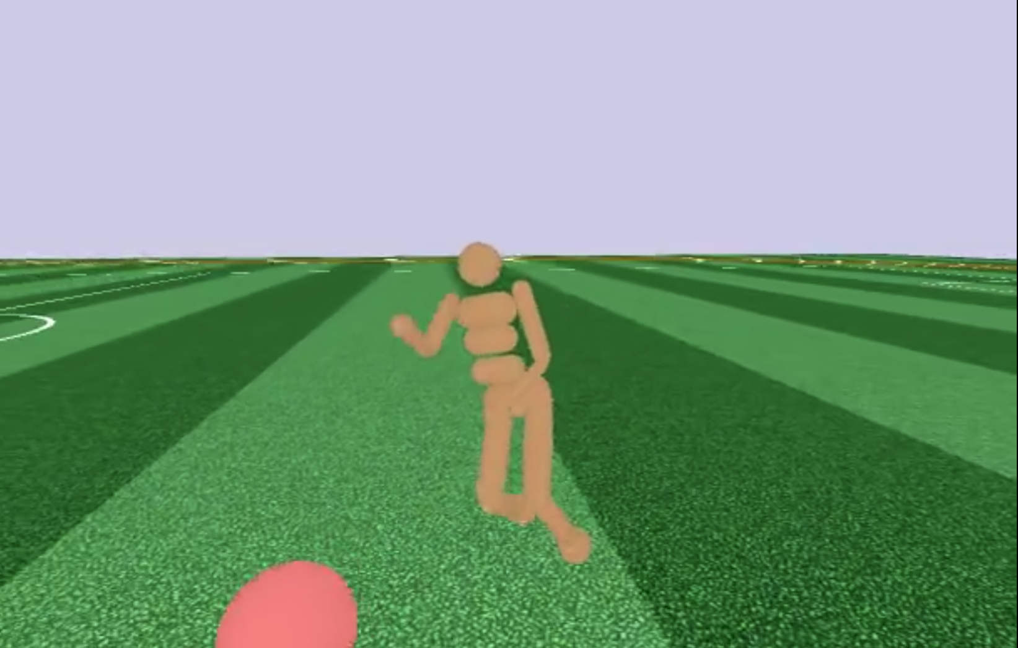
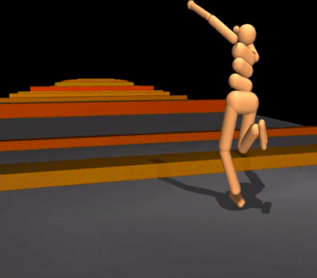
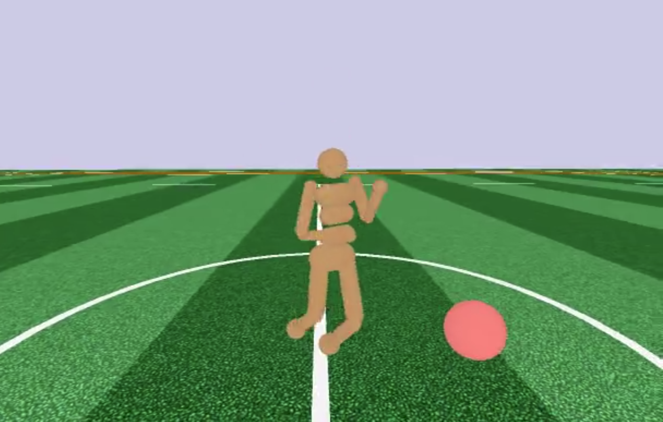
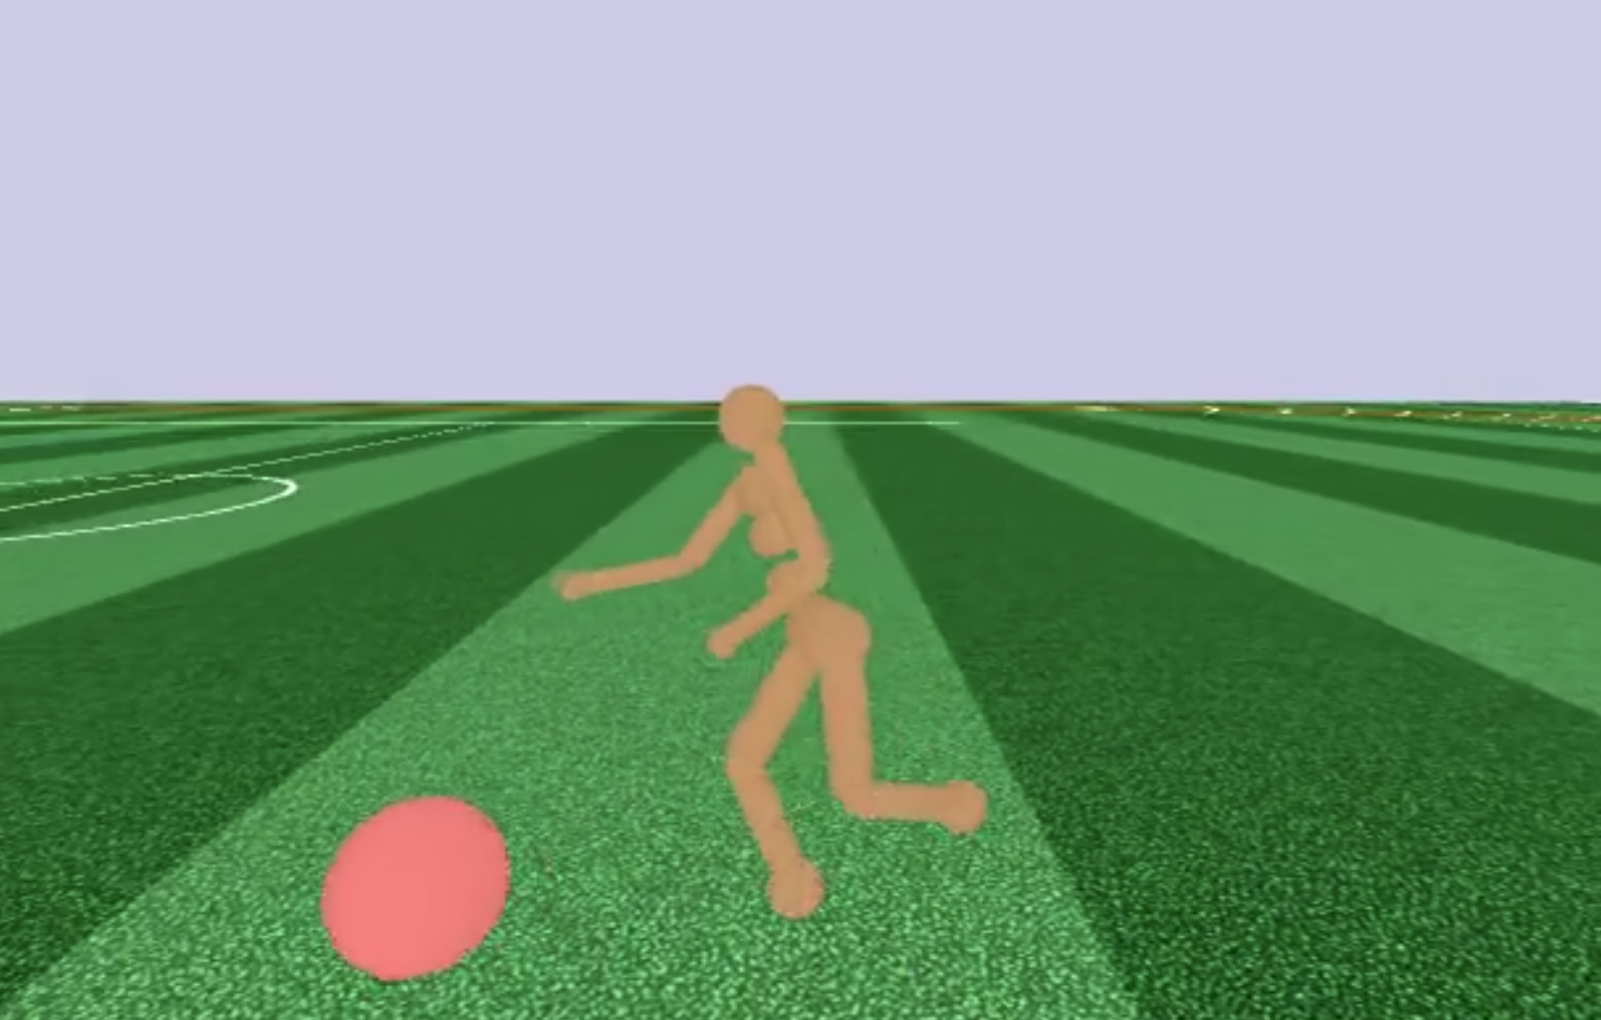
Proximal Policy Optimization
Based on Policy gradient methods
Best performance on continuous control tasks
Simple to implement and handle
Good sample efficiency
A simulated 'humanoid' walker
A simulated 'humanoid' walker learns to move forward in an unfamiliar terrain
Sources: Nicolas Heess et al. Emergence of locomotion behaviours in rich environments. https://deepmind.com/blog/producing-flexible-behaviours-simulated-environments/
Sources: Schulman et al. "Proximal policy optimization algorithms." arXiv preprint arXiv:1707.06347 (2017). | https://blog.openai.com/openai-baselines-ppo/ |
Nicolas Heess et al. Emergence of locomotion behaviours in rich environments. https://deepmind.com/blog/producing-flexible-behaviours-simulated-environments/
Notes:
PPO is based on Policy gradient methods.
These are offered recent breakthroughs for control of 3D locomotion.
---
Policy gradient methods have a mein problem in estimation the step size of a policy update.
Previous approaches try to calculate the step size.
This approach solves the problem with the step size by directly constraining it.
The policy is trained to increase the likelihood of actions that give high reward.
It handles continues action and state space. In the Experiments of Jon schulman at Open AI it achieved the best performance in those continues control tasks.

Slide 21
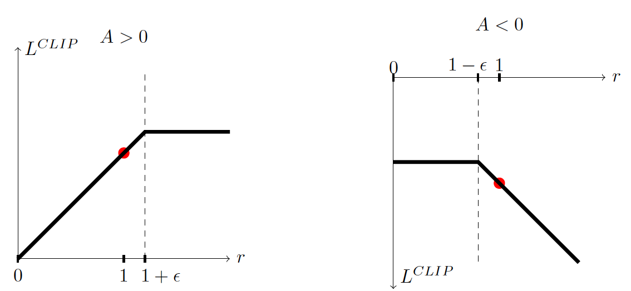
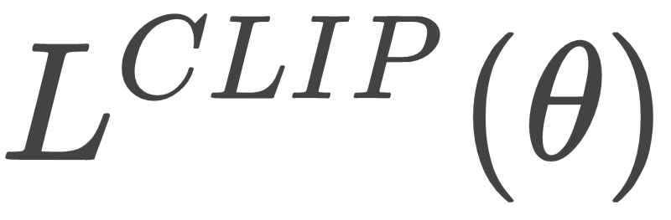
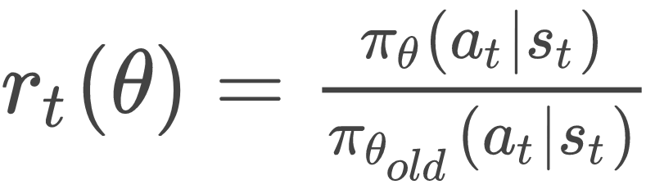
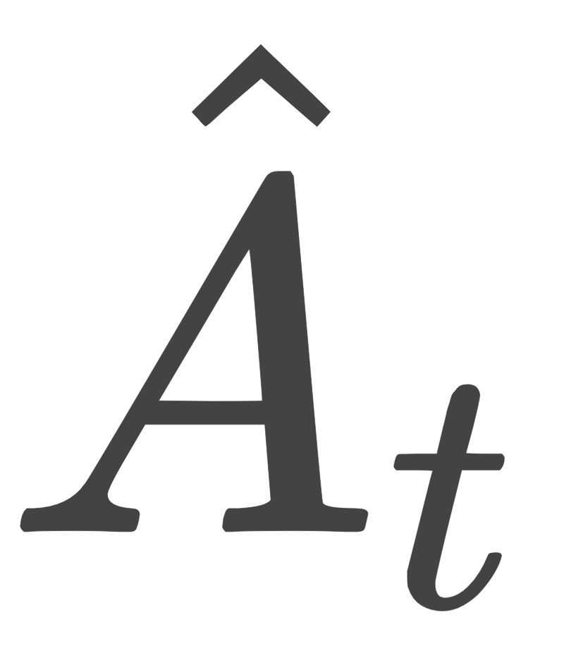
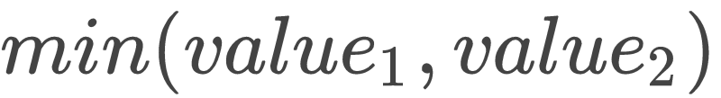



Proximal Policy Optimization
Components
Objective function
Probability ratio
Advantage function
Min function
Clip function
Clipping parameter
Sources: John Schulman, Filip Wolski, Prafulla Dhariwal, Alec Radford, and Oleg Klimov. Proximal policy optimization algorithms. 2017.
Notes:
PPO: Have some benefits of trust region policy optimization (TRPO), but they are much simpler to implement, more general, and have better sample complexity (empirically)
PPO outperforms other online policy gradient methods,
overall strikes a favorable balance between sample complexity, simplicity, and wall-time
How to solve the problem of too large policy updates?
Clipped Surrogate Objective
The clip function component clip(value, min, max) of L CLIP (θ) is responsible to limit the update of the policy.
This is special in PPO (clip)
Instead of trying to find the right amount for a step size, it directly limits it by defining a minimum and maximum value.
A_t represents an estimation of how good an action was in a state compared to the average of all actions in that state.
----
^A_t is an estimator of the advantage function at t.
GAE tackles “credit assignment problem”. The ...
Even implements a Actor-Critic structure with value function approximation.
https://towardsdatascience.com/introduction-to-various-reinforcement-learning-algorithms-part-ii-trpo-ppo-87f2c5919bb9

Slide 22

Proximal Policy Optimization
Sources: John Schulman, Filip Wolski, Prafulla Dhariwal, Alec Radford, and Oleg Klimov. Proximal policy optimization algorithms. 2017.
Notes:
We’ve previously detailed a variant of PPO that uses an adaptive KL penalty to control the change of the policy at each iteration. The new variant uses a novel objective function not typically found in other algorithms:
Policy Gradients Methods:
But getting good results via policy gradient methods is challenging because they are sensitive to the choice of stepsize — too small, and progress is hopelessly slow; too large and the signal is overwhelmed by the noise, or one might see catastrophic drops in performance. They also often have very poor sample efficiency, taking millions (or billions) of timesteps to learn simple tasks.

Slide 23


1. Experiment: Autonomous Locomotion Control
Reward Function
Reward is combination of velocity and Power usage
Both are normalized and multiplied together
Notes:
just training to reach the most efficient locomotion doesn't work. The snake would learn to not move at all.
TODO how power measured
TODO üben des gut zu erklären!
Bla hier gut …, da target velocity, da weniger power used…

Slide 24


Power measurement

Slide 25

1. Experiment: Autonomous Locomotion Control
Equation controller
Traditionally locomotion gait

Slide 26
Observation Space

Slide 27
2. Experiment: Autonomous Target Tracking
Result: Zigzag-Track (1/4)
Distance
Mean: | 3.96 m
Std: | 0.24 m

Slide 28

2. Experiment: Autonomous Target Tracking
Result: Line-Track (2/4)
Distance
Mean: | 3.99 m
Std: | 0.18 m
Notes:
Letz evaluate the controller on different tracks.
On the tob the movement of the snake.
X axes the traveled way.
Here it is a straight line.
Green is the head position of every time step
At the bottom the distance to the target.
It is able to keep the distance in a reasonable distance.
---
ordentlich erklären
genau die stelle der erste grapherklärung paar mal üben auf jeden fall

Slide 29
2. Experiment: Autonomous Target Tracking
Result: Wave-Track (3/4)
Distance
Mean: | 3.99 m
Std: | 0.24 m

Slide 30
2. Experiment: Autonomous Target Tracking
Result: Random-Track (4/4)
Distance
Mean: | 3.88 m
Std: | 0.22 m

Slide 31




2. Experiment: Autonomous Target Tracking
Result
Stops to keep distance
Uses different
Path following behavior
Does not face the target directly
Notes:
No need for image processing. No need for defining a gait and locomotion.
Todo
p20 das mit behavior und distance check ich nich
btw die videos gehen nur für dich. mach die vllt offen damit im notfall bing die presi bei sich aufmachen kann und du so halten kannst
Green is the absolute

Slide 32

Learning process

Slide 33
1. Experiment: Autonomous Locomotion Control
Reward Function
Notes:
just training to reach the most efficient locomotion doesn't work. The snake would learn to not move at all.
TODO how power measured
TODO üben des gut zu erklären!
Bla hier gut …, da target velocity, da weniger power used…

Slide 34
1. Experiment: Autonomous Locomotion Control
Reward Function
Notes:
just training to reach the most efficient locomotion doesn't work. The snake would learn to not move at all.
TODO how power measured
TODO üben des gut zu erklären!
Bla hier gut …, da target velocity, da weniger power used…

Slide 35

Training 1

Slide 36

Training 2

